Slide 1
CSE3002 - Internet and Web Programming
Online Quiz System
V. Venkata Narendra -18BCE0515
Rishabh Panchal -18BCE2275
Rtvik Katarya -18BCE0837
S.Kishore Kumar – 18BCE2221
Slot: E1
Guided by: Dr Lokesh Kumar R

Slide 2
Aim
Project :ONLINE QUIZ SYSTEM
To develop a website that would full fill the requirement of instructor and student along with a administrator who could manage and provide few services like authentication and authorisation jobs like accepting teachers etc.. and for conducting and attempting the quiz more efficiently.

Slide 3
Abstract
Due to various reasons like COVID , more work in order to type questions then get it printed later evaluate manually one by one , mis counting etc.. has paved a better solution called online Quizzes .
Today many online quizzes are set up to actually test knowledge or identify a person's attributes. Some companies use online quizzes as an efficient way of testing a potential hire's knowledge without that candidate needing to travel. Online quizzes are a popular form of entertainment for web surfers. Even almost all the govermnent or competitive exams are been taken through online these days and this online quiz can give almost the same feel of giving a real exam . Online quizzes are generally free to play and for entertainment purposes only though some online quiz websites offer prizes. Websites feature online quizzes on many subjects.

Slide 4
Introduction :-
Online Examination System refers to service as conduct online examination or test. It will use for students progress evaluation using modern computer technology. It replaced the paperwork and overcome the outcomes of traditional way of examinations using paper or pen.It is web based platform can be used by Admin at any remote location. Online Examination System is fully developed automated system is to efficiently evaluate the candidate progress that not only save the time of Examination Controller and also gives fast result. The Administrator of the system has authority to propose tests or papers. It is cost effective and time effective.The candidate can login through proposed computer with their Enrollment number matching the details to the student’s database, then they can take the exam. Candidate can give their course’s examination in a specific duration and in specific number of questions.

Slide 5
Objectives :-
Any student can register with out permission , and teacher can register with the permission of admin .
Only registered members view the quiz.
There are three roles available: Student,teacher and admin.
A teacher can add subjects and set any number of questions along with different marks assigned for each question .
A student can attend a quiz of any subjects he selected .
Students can send feedback for the quiz.
Teachers and students can upload profile pictures.
Teacher can view the marks of student and delete an exam .
Admin can do all the works done by teacher along with it he is the one who sets salary for teacher and accepts his request
About us page is available to display our project details .

Slide 6
Technologies required :-
HTML
CSS
PHP
Java script
Django

Slide 7
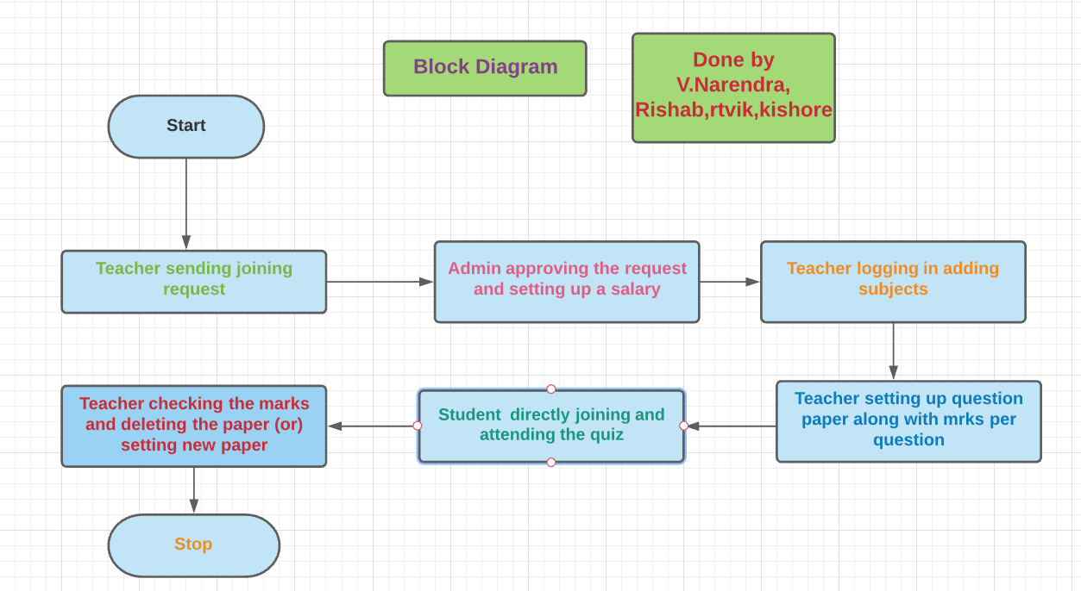
Block diagram :-
.

Slide 8
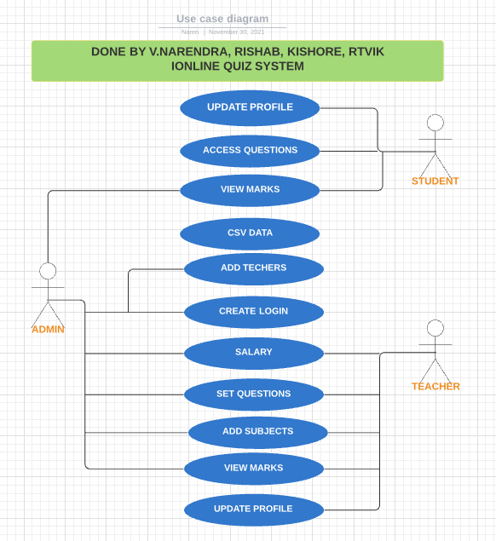
Use case diagram :-
.

Slide 9
Methodlogy :-
Initially we have divided the project into 4 parts
1. Back end worked on django
2. Admin portion
3. Student portion
4.Teacher portion
For each interfaces pages are designed and connected based on the action is done like moving to next page or adding questions so on..

Slide 10
Conclusion :-
This project is designed in such a way that future modification can be done easily. The following conclusion can be deduced from the development of the project.
Our project provides a friendly graphical user interface.
Adding permission based acceptance for student to get enrolled in a particular subject .
Making the admin make a priorities for teachers so that in his absence that particular teacher could handle the requirements .
Adding a video solution to the question instead of theoritical explaination .
Student can raise a doubt if he feels that answer is incorrect .

